Slide 1
Thermostat
Projects and laboratory on communication systems 2018/2019
Students:
1

Slide 2
Outline
Introduction
Topic 1
Topic2
Topic 3
Topic 4
2

Slide 3
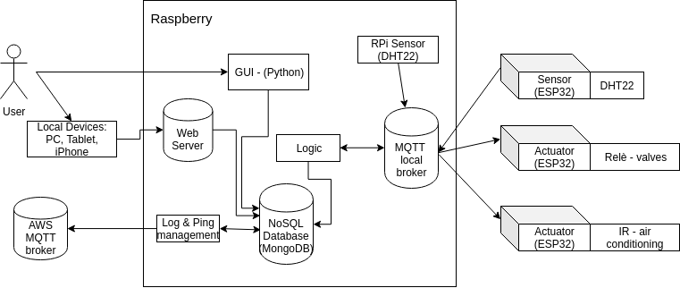
Introduction – A Top-Down Approach
GUI and UX
Backend SW Logic
External Devices
3

Slide 4
GUI and User Experience
Goal: provide a simple but functional interface for the end user
How: functionalities over fancyness easy of use is a top priority
What we provide:
An On-Board Graphical User Interface (PyQT5 Framework)
A Web User Interface accessible from the home Local Network
4

Slide 5
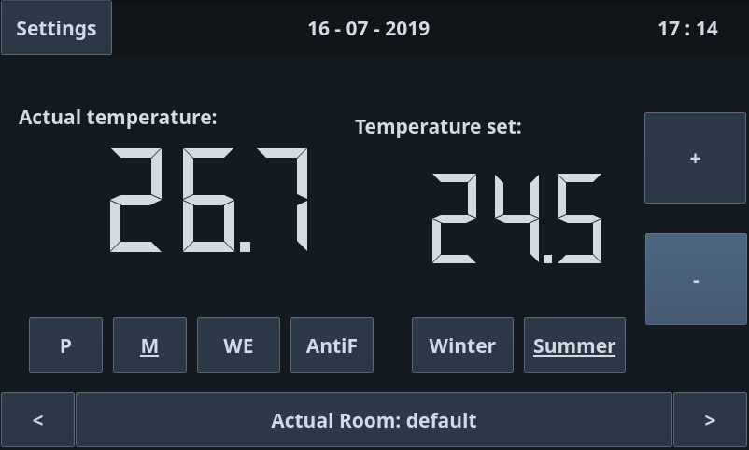
Welcome Window
Available Modes:
Programmable
Manual
WeekEnd
AntiFreeze
Seasons:
Winter
Summer
Room Slideshow
5

Slide 6
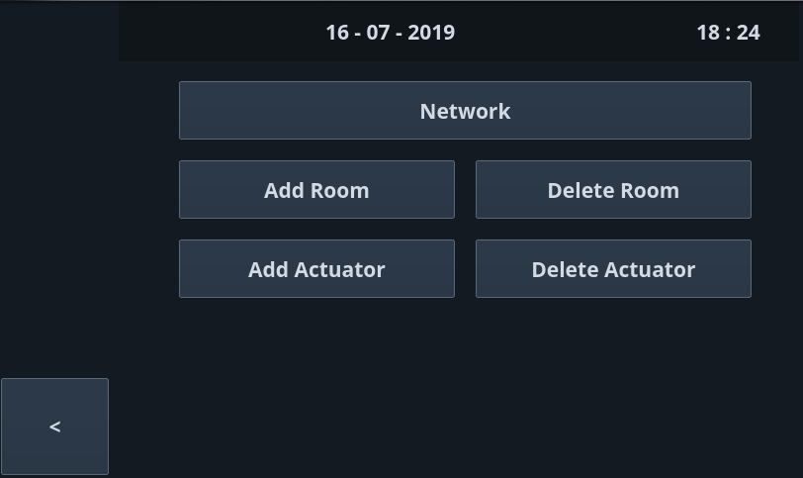
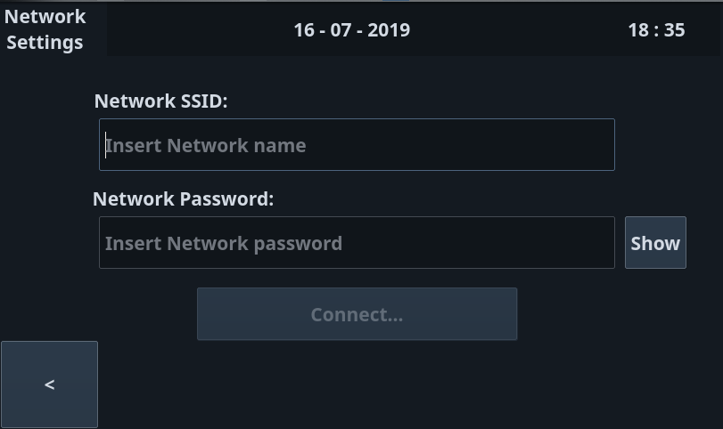
Room Functionalities
Network:
Connection to Home WiFi network
SSID + Password
Linux tools: wpa_supplicant, iw, ping
Room:
Add/Delete Room
Mnemonic (ex. "Kitchen")
Deleting a room will logically delete all actuators and valves connected to it
Actuator:
Unique ID
Shares the same connection method with a Sensor
6

Slide 7
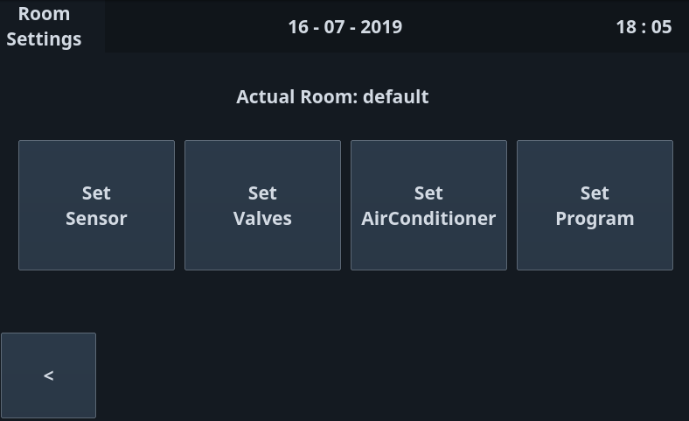
Room Functionalities
Sensor:
Unique ID
Collect temperature of actual room
Bluetooth during the connection phase
WiFi + MQTT once connected
Valves:
Unique ID, from 1 to 8
Linked to an Actuator, which must be already visible to the system
Summer
AirConditioner:
Shares similar properties with a Sensor
IR Blaster
Program
Timetable definition
7

Slide 8
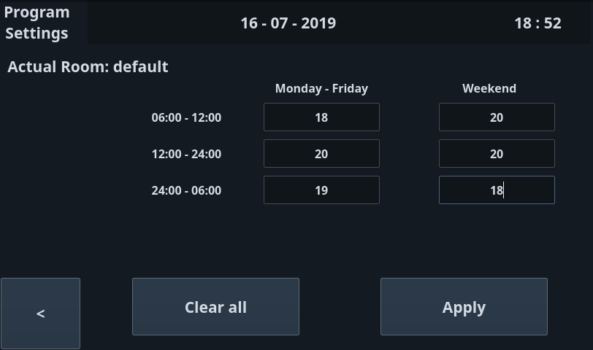
Room Functionalities
Program:
Working Days + Weekend
Morning Temperature
Evening Temperature
Night Temperature
Program is activated iff Program Mode is enabled
8

Slide 9
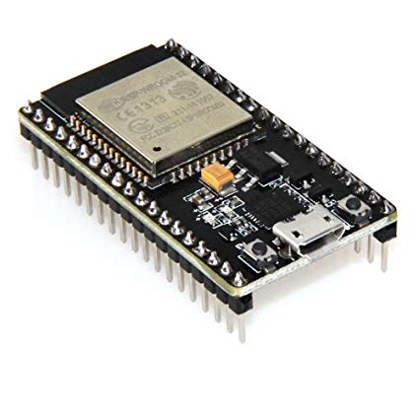
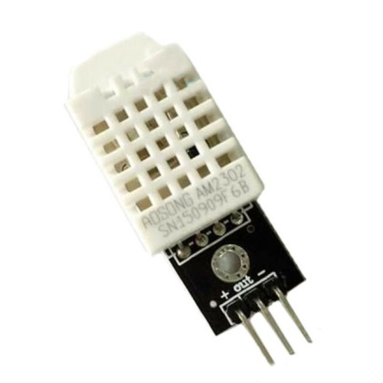
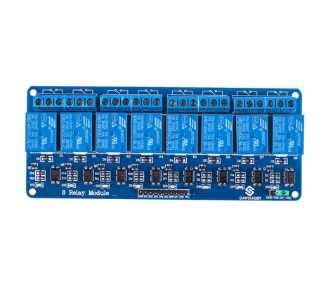
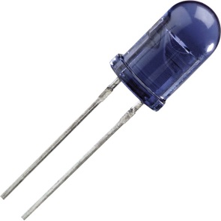
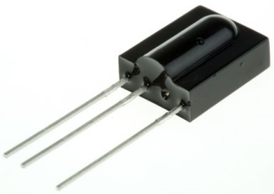
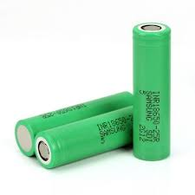
Hardware used
ESP32 board
DHT22 temperature sensor
Relè module
IR transmitter and receiver
Li-Ion batteries and relative circuit
3

Slide 10
Motivations
All the components used in this project respect this requirements
Availability among group members
Availability of libraries on the intenet (see DHT22)
In any case all the components had to be compliant with the project specifications
3

Slide 11
Example of compliance
Project specification : Temperature must be controlled in the range from -10 °C up to +40 °C with an accuracy of 0,5 °C
DHT22 accuracy and range : 0.5 °C accuracy, range -40 °C up to 80 °C
DHT11 accuracy and range : 1 °C accuracy, range 0 °C up to 50 °C
Our choice was the DHT22 due to the previous reasons
3

Slide 12
MQTT topic used
Each ESP32 subscribe/publish to different topic depending on its function
ESP32 as sensor : publish on topic temperatures
ESP32 as IR actuator : subscribed to topic actuator/cold/roomID
ESP32 as valve actuator : subscribed to topic actuator/configuration and actuator/configuration/roomID
3

Slide 13
RPi core logic
Central component of the system, gives life to devices interactions
Retrieve all Temperature messages
Decides which actuator must be driven and its working mode
Example
SE3
Example
SE3
Example
SE3
Needs an access point to the broker, in order to control the messages flow
Needs a Storage to save and retrieve interesting informations

Slide 14
RPi Connection Manager
MQTT protocol adopted to allow devices communication
MDNS is exploited in order to make the raspberry reachable from its local net
The MQTT broker resides in the RPi, Mosquitto was used
Example
SE3
Example
SE3
Example
SE3
Connection Manager component is used by the logic to subscribe/publish

Slide 15
Rpi Database Manager
Common source of interesting informations for every component of the system
Informations always updated and shared, race condition avoided
NoSQL DB stores informations in documents, format used to send messages. No data manipulation needed.
Example
SE3
Example
SE3
Example
SE3

Slide 16
Web Application
..
..

Slide 17
Thanks for the attention

